Slide 1

Introduction to
Javier Perez
Director of Product Management, Red Hat Mobile

Slide 2

Mobile is Everywhere
Companies benefit from mobile apps
Better Work Productivity (63%)
Customer Satisfaction Scores (50%)
More Services Revenue (19%)
New Sales Revenue (13%)
Less Paperwork (63%)
Travel Time (31%)
Notes:
Source: TSIA http://blog.tsia.com/blog/emerging-trends-in-mobility-for-field-services
Field Technologies Online Survey 2014 - More than half, 52 percent, of survey respondents state their field workers use consumer-grade handhelds and smartphones

Slide 3
Mobile: a Catalyst for transformation
“38 percent of total IT spending is outside of the formal IT organization already, with a disproportionate amount in digital.
By 2017, this number will grow to more than 50%.
Gartner, Drive Digital Business with Insights from Symposium, Nov 2014
Notes:
Different quote needed here.

Slide 4
Driving digital transformation
2010-13
CONSUMERIZATION
2013-16
MOBILE-FIRST
2016+
DIGITAL ENTERPRISE
iOS Support
Experiment Apps
Point Solution
Risk Management
Multi-Device
Targeted Apps
Dev Platform
Business Enablement
Wearables
Internet of Things
Mobile Architecture
Business Transformation
Device-centric App-centric Information-centric
Notes:
Speaker slide content

Slide 5

From systems of record
HCM
ERP
Reservations
CRM
ETC.
Notes:
Speaker slide content

Slide 6

To systems of engagement
Notes:
Speaker slide content

Slide 7

Why a Mobile Application Platform?
Apps
Development Tools
Mobile Device Platforms
Form Factors
Back-End Systems
In-House Integrations
3rdParty Integrations
Developers
Versions

Slide 8
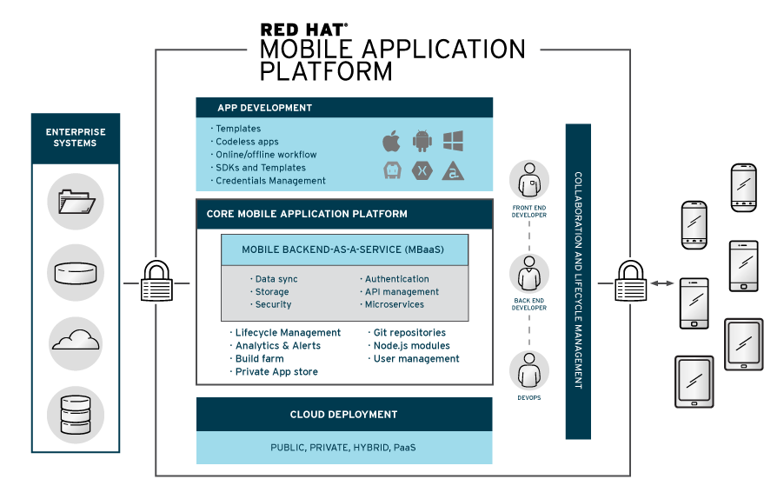
Notes:
Speaker slide contentWhat we can do for mobile app development: Full support, BYOT, easy migration and templates and drag& drop

Slide 9
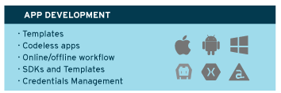
Notes:
Speaker slide contentWhat we can do for mobile app development: Full support, BYOT, easy migration and templates and drag& drop

Slide 10
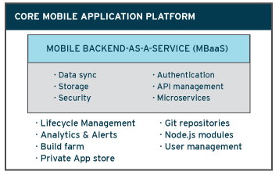
Notes:
Core Functionality with a Lifecycle management, CollaborationBuild farm, Analytics, monitoring, git repos
MBaaS, APIs for storage, caching and data sync

Slide 11






The new world of Enterprise Mobility
Open technologies, cloud or hybrid-cloud solutions
Flexible development using any client toolkit
REST APIs for apps to consume
JavaScript and Node.js as integration logic
MBaaS to simplify & speed app development
Continuous development & deployment
Collaboration between front-end developers (new IT) with backend developers and ops (traditional IT)
Notes:
Top features of RED HAT Mobile Application Platform

Slide 12
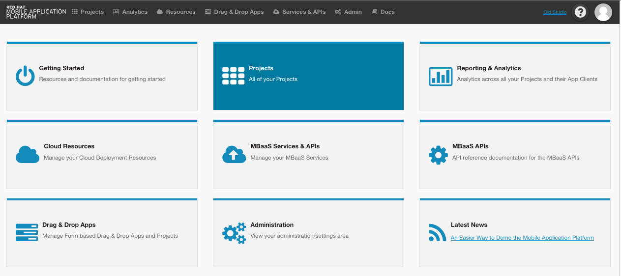
Red Hat Mobile Application Platform
Notes:
On-line dashboard-based UI
Project-based structure

Slide 13
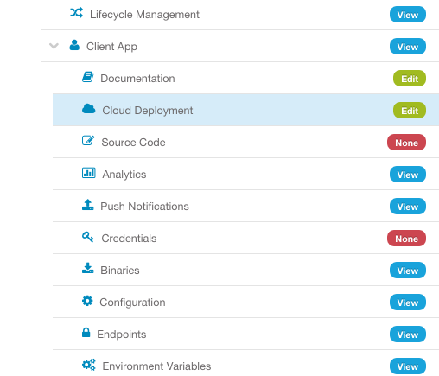
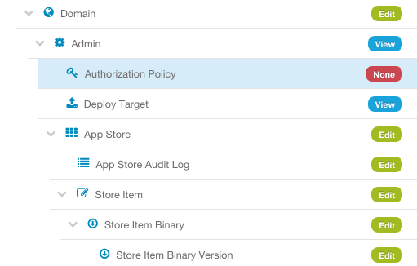
Enhanced TeamS and Collaboration
To define teams and provide access to all components
Notes:
Fine-grained role access to every component in the platform.
Can create multiple teams, for example Client side teams, Backend dev teams

Slide 14
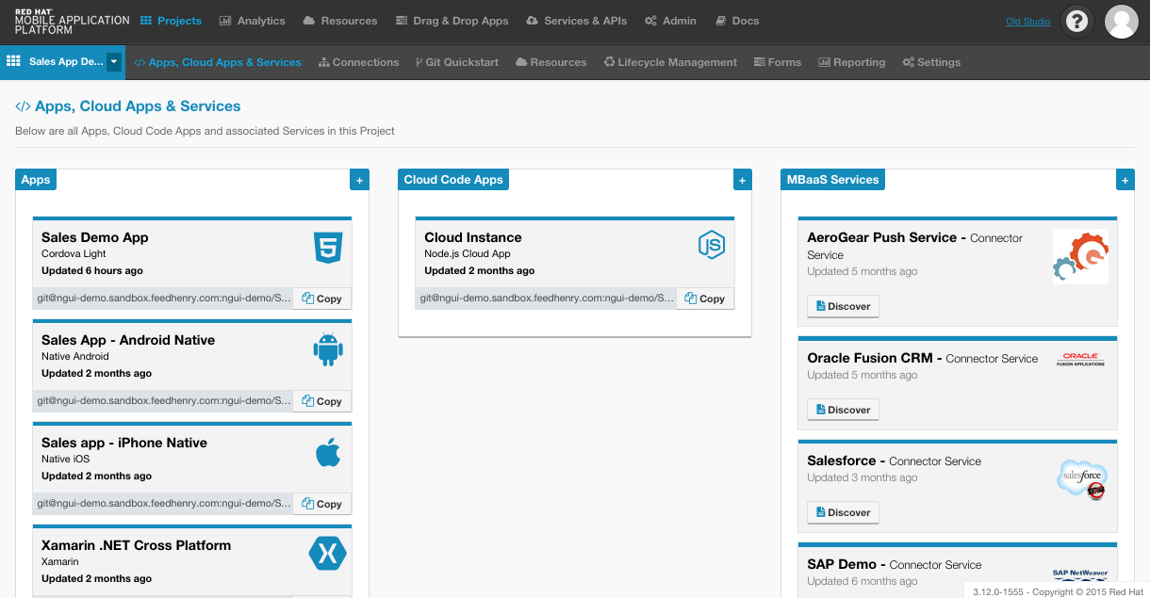
Client, Cloud & MBaaS Services
Notes:
Explain client code and cloud code

Slide 15
Core Platform, Node.js

Slide 16
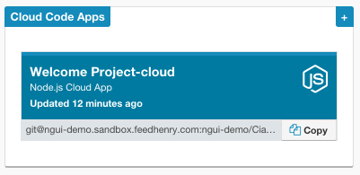
Core Functionality, API-based, Node.js
Data Sync
API Keys
Cloud Alerts
Deploy Targets
Env Variables
User Admin
App Management
Cloud Env
Caching
Storage
Notifications
User Roles
Auth
Stats

Slide 17
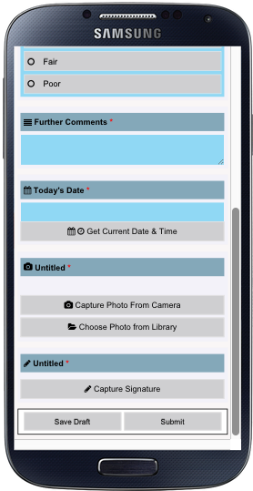
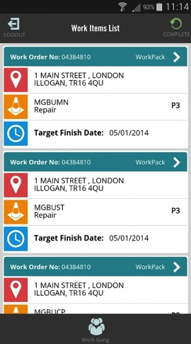
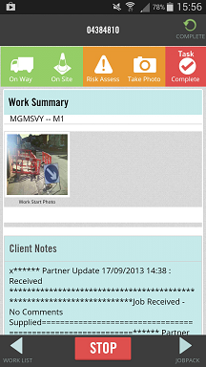
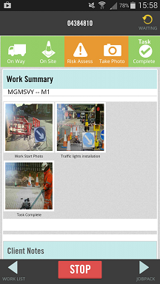
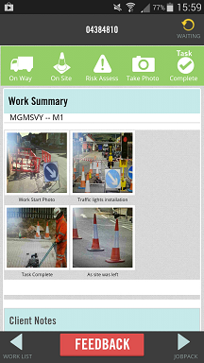
Data Sync Framework
Provides a mechanism to manage bi-directional data synch from multiple app to cloud and backend systems
Allows delta updates to be distributed from Cloud to connected clients
Provides facilities for managing data collisions
Notes:
Allows mobile apps to use & update data offline (local cache)
This service effectively allows Apps to seamlessly continue working when the network connection is lost, and allow them to recover when the network connection is restored

Slide 18
MBaaS Services- Microservices
Notes:
Explain what MBaaS service is ~ microservices

Slide 19
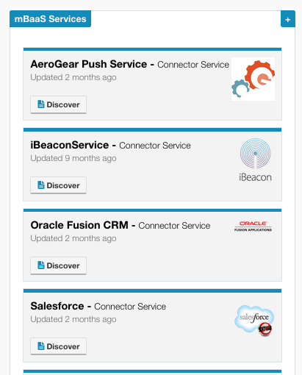
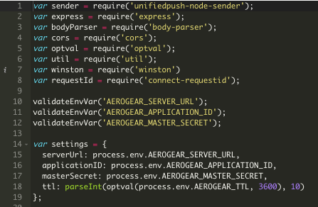
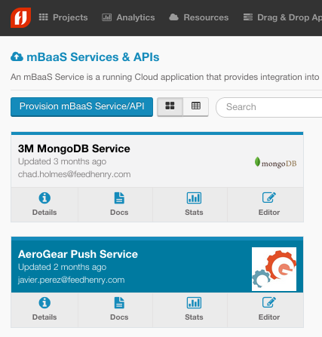
MBaaS Services - Microservices
IDENTIFY INTEGRATION POINTS
BUILD YOUR NODE.JS MODULES
DEFINE IT AS RE-USABLE SERVICE
BUILD YOUR APP WITH AVAILABLE SERVICES
JSON/REST
XML/SOAP
OData
Notes:
How it works, what the developer needs to do

Slide 20
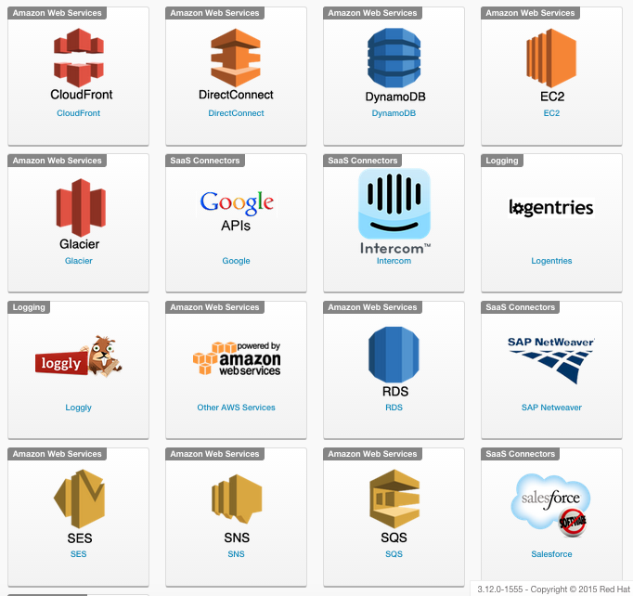
MBaaS Services
Cloud APIs
Public APIs
Local & Third party storage
Node.js Server-side
Large ecosystem of node.js modules
Discoverable, testable, documented APIs
Re-usability of MBaaS services
Secure Network/VPN config
Notes:
Node.js based MBaaS, 150K node.js modules available in the ecosystem NPM

Slide 21
Client side

Slide 22
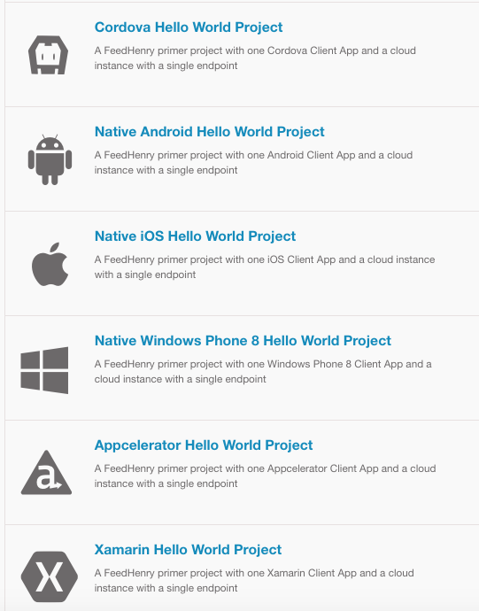
Sample apps & Templates
Easily extend examples to build your own Apps
Best practice for interacting with the Platform APIs
Best of breed modern frameworks
angular.js, backbone.js, ember.js, ionic, xamarin, appcelerator
Optimized for team-based development with multiple Git repos
Variety of available sample forms-based apps

Slide 23
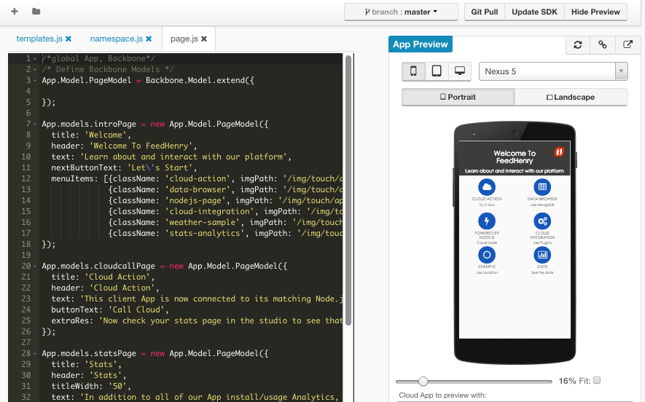
Client-side App Development
Online/Local development
Command line access
HTML5, Hybrid & Native
Cloud Build Farm
Git SCM
HTML5 Form App Wizard
Credentials Management

Slide 24
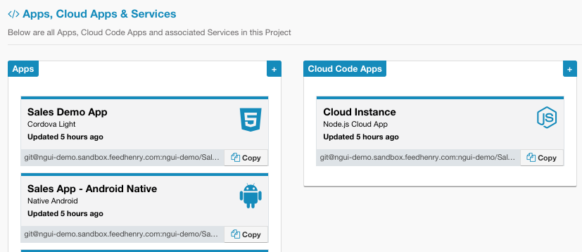
Migrating existing Mobile apps
ANY NATIVE OR HYBRID MOBILE APP
CREATE OR USE EXISTING PROJECT
IMPORT FROM ZIP, GIT OR BARE REPO
YOUR APP & NEW CLOUD APP GENERATED
ADD PLATFORM FEATURES TO YOUR APP
Existing apps:
Notes:
Important that even enterprises already have mobile apps, they can take advantage of our platform by migrating with a few easy steps

Slide 25
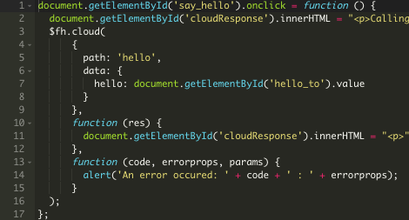
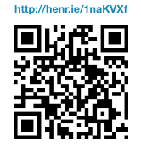
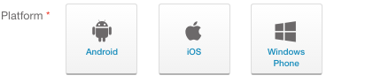
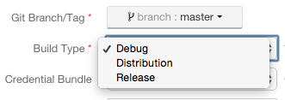
Cloud Build Farm
CODE YOUR MOBILE APP
CHOOSE YOUR DEVICE PLATFORM
BUILD FOR DEBUG OR DISTRIBUTION
APP IS BUILT,
CLOUD BUILD FARM GENERATES BINARIES
Notes:
Hybrid and Native apps
Updated Apache Cordova/PhoneGap 3.x Build support
Import existing mobile and web apps such as PhoneGap
Support for Hybrid Apps with all Cordova Plugins
Windows Phone 8 SDK for native app development and build
Native Android, iOS and WP8 build support
Xamarin and Appcelerator Titanium support
Auditing and Log files
App binary build history with credential bundles

Slide 26






Full process flow to build an app
frontend developer
CODE YOUR CLIENT APP
BUILD YOUR APP ON THE BUILD FARM
DOWNLOAD AND INSTALL ON DEVICE
CREATE A PROJECT IN THE PLATFORM
PLATFORM CREATES CLIENT & CLOUD APPS
ADD FUNCTIONALITY TO YOUR CLOUD CODE
ADD SERVICES TO YOUR APP
DEPLOY YOUR CLOUD CODE
API
backend developer
Container image
Notes:
High level steps to build apps on Red Hat Mobile Application Platform, important to understand the benefits of cloud side development, re-usable services and cloud deployment

Slide 27
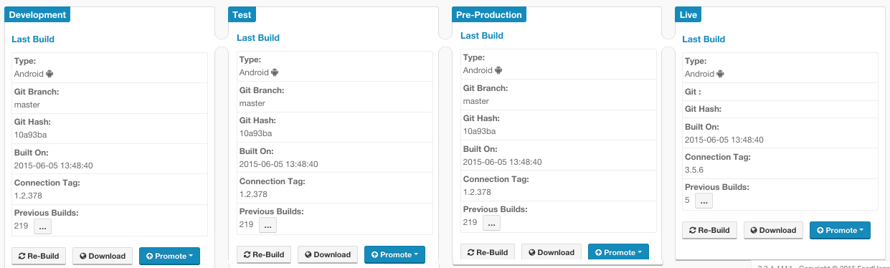
Application Lifecycle Management
Provides the ability to define a set of software environments e.g. Dev, Test, Pre-Production, Production. Enables DevOps processes in a mobile context
Notes:
Provides the ability to define a set of software environments e.g. Dev, Test, Pre-Production, Production. Enables DevOps processes in a mobile context
Provides the ability to identify and deploy sets of software artifacts repeatedly to different environments

Slide 28
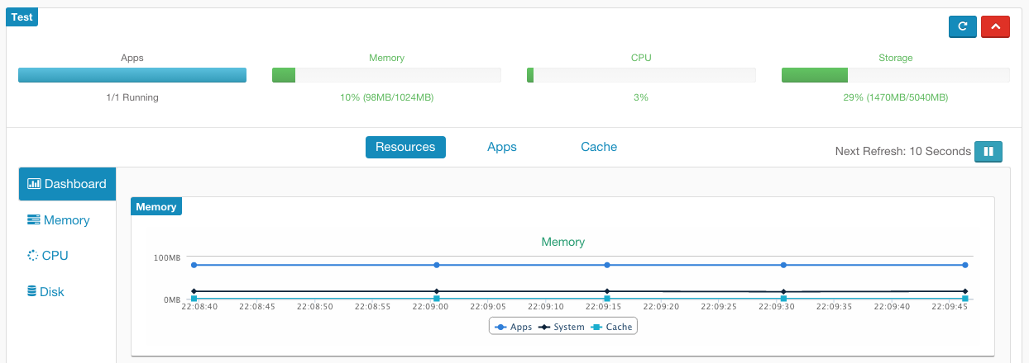
Resource Management
App cloud performance and utilization resource monitoring and alerting
Aggregated and individual app level views of memory, CPU, disk and cache

Slide 29
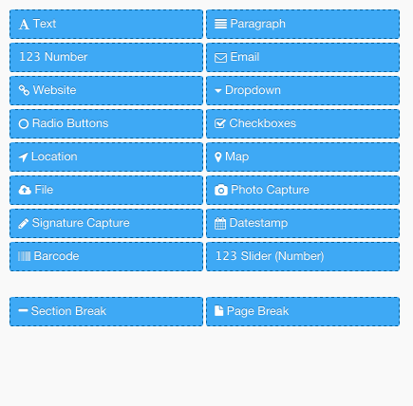
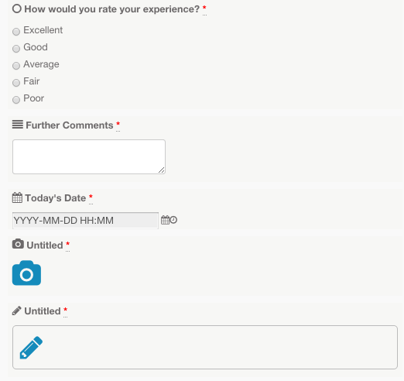
Drag & Drop Forms Builder
View Form submissions including images and signatures
All form fields available including photo, gps, bar code scanner, signature capture, ...
Notes:
Form in an app, drag & drop builder with the use of Build Farm a none developer can build apps
Check available Paperless eBook

Slide 30
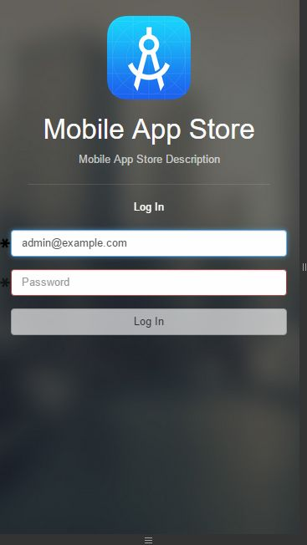
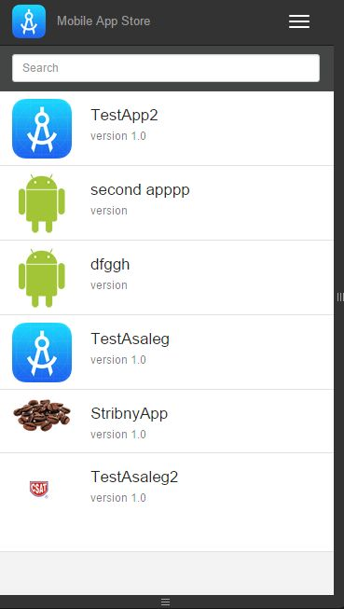
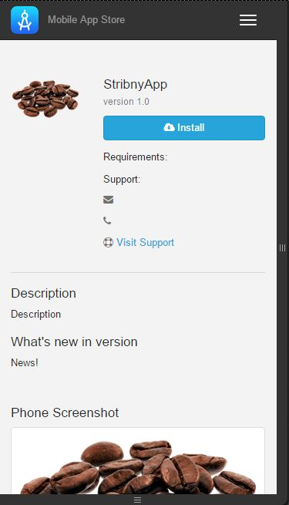
Private App Store
Updated app store for internal distribution of your apps
Notes:
Available Private app store if customers do not have an MDM solution (Cetrix, MobileIron, AirWatch, Good Technology).
Employees can download the app from a URL

Slide 31
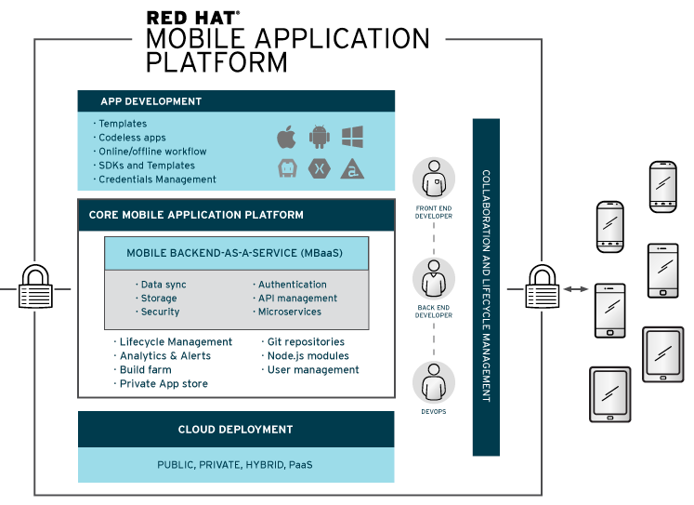
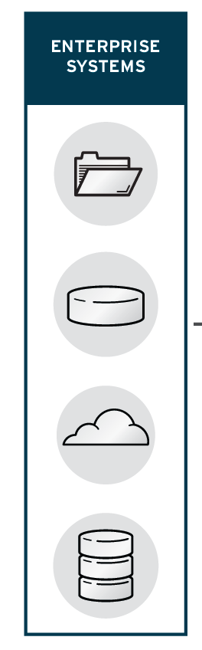


Complements Jboss & Openshift
Notes:
RH Mobile Application platform fits very nicecly with other middleware product, great complement to BPM-based solutions that need mobile apps, or taking advantage of existing integrations that Jboss Fuse brings

Slide 32
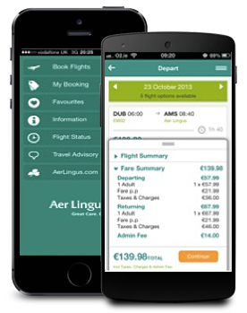
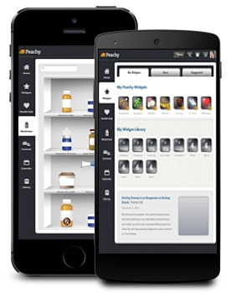
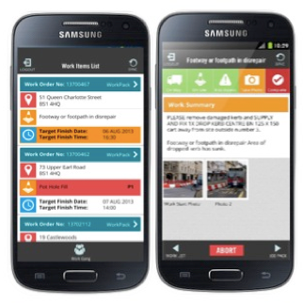
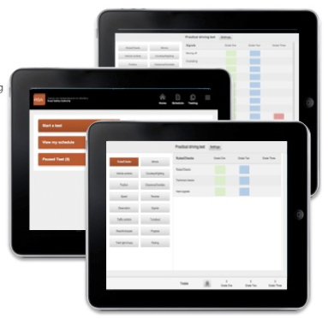
SINGLE PLATFORM FOR ALL SOLUTIONS
Consumer Apps (B2C)
Partner Apps (B2B)
Order/Re-order
Account self-service
Quotations
Portfolio management
Invoicing
Travel
Retail
Banking
Business Services
Customer service
Employee Apps (B2E)
Business Apps (B2B)
Supply-chain
Delivery & Distribution
Order management
Asset management
Workforce Scheduling
Sales team support
HR self-service
Expenses

Slide 33

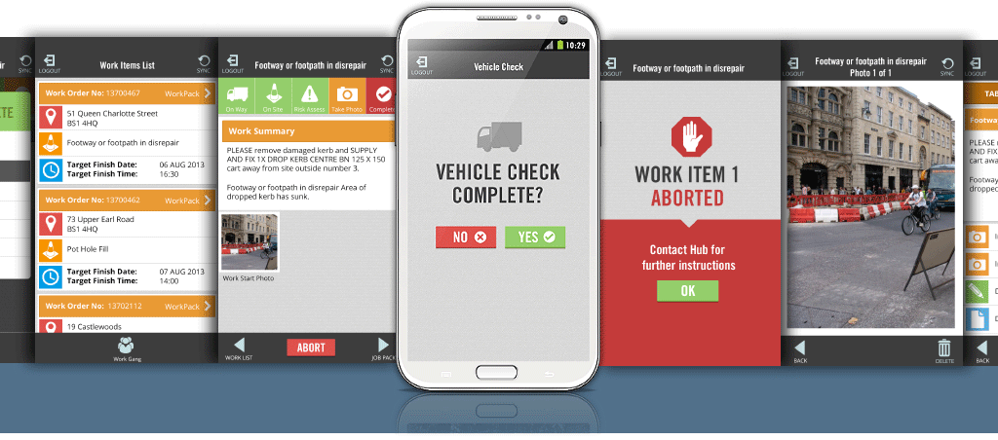
Use Case 1: Work Order Management
Complex work order management solutions for field service workers in the UK, rolling out to 10,000+ workers
Use of Video, photo, location & signature capture phone features, continue expanding the number of apps
Complex integration with legacy backend inventory and asset management systems
Ease of integration with backend systems

Slide 34

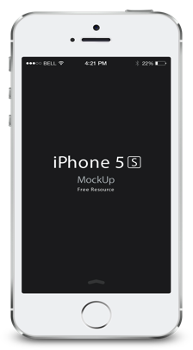
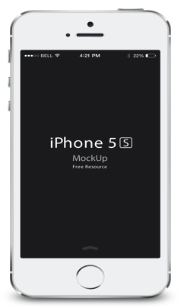
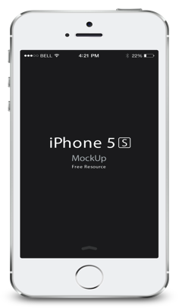
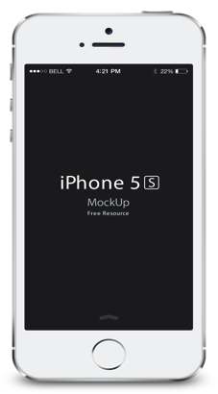
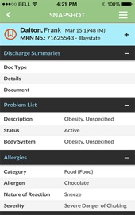
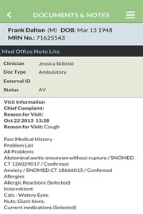
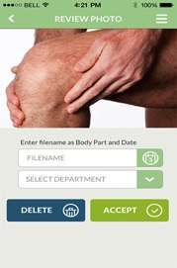

Use Case 2: Clinical Patient Data
Patient Data Viewer
Clinicians can access patient info on-the-go, increasing response times
Secure integration to Patient Info Exchange via cloud
Authenticated and Authorized Access
Available iOS & Android smartphone and tablets
Injury Photo Capture
Patient records retrieved and photos captured
Data Integration with Cerner Information Systems (Medical Records)
Secure integration to increase security layers and encrypted communication

Slide 35
License Model
Subscription to the hosted platform based on number of users
B2E – per user per month being the staff who are accessing apps hosted on the platform
B2C – total active users per month being the number of consumers who use the app in a given month
Pricing is tiered so higher subscription volumes will enjoy higher levels of discount
Professional services also available: App Dev, Workshops and Training

Slide 36

Positioning and Marketplace
Enterprise Focus
-end-to-end
Enterprise-Grade
Cloud
Open, Flexible & Agile
Legacy
MEAP/MADP
Database centric
Proprietary
On-Premise
High Price
mBaaS
Lightweight
Developer focus
Consumer focus
Consumer Focus
- partial/point solution
Proprietary
On-premise
Open & Agile
Cloud

Slide 37






MEAPs or MADP
Mobile Enterprise Application or Development Platforms
Integrated development tool
Connectors to legacy applications
Platform lock-in
Proprietary run-time server
Mostly on-premise deployment very few deployments on the cloud
Centralized administration
Expensive investment (hw & sw)
High cost of customizations
Consulting services required
MADP

Slide 38







MBaaS
Mobile Backend as a Service vendors
All started with consumer apps and developers focus
Successful MBaaS vendors have been acquired and terminated service or re-focus strategy: Stackmob and Parse
All Cloud based, none cloud agnostic
Proprietary run-time server
Only StrongLoop is built with node.js
Lack of enterprise IT features for monitoring, life cycle management and Ops support
MBaaS

Slide 39
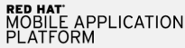



Enterprise Mobile Application Platforms
Focus on enterprise grade product and enterprise customers
Multiple cloud deployment options
Have stepped up Marketing
Competitive technology advantage on RFPs
Only regional presence (except Salesforce)
Focus on technology, platform management and scalability
Lacking support and professional services capabilities

Slide 40

Red Hat Mobile Application Platform
Focus on enterprise grade product and enterprise customers
Flexible Cloud options with world class Ops team
Latest technologies & open standards
Node.js cloud plugins & reusable MBaaS Services
Competitive technology advantage on evaluations
Cloud Binary Build Service including any Cordova plugin
Lifecycle Management, multi-environment support
Drag-and-Drop Forms Apps builder

Slide 41
Thank you !
openshift.feedhenry.com
eBooks and Documentation
http://www.feedhenry.com
http://docs.feedhenry.com/v3
Demos
http://henr.ie/Platform101
Twitter
@RedHatMobile
Email
mobile@redhat.com

